Slide 1
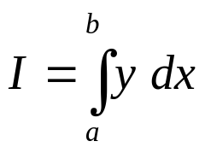
Introduction
The general problem of numerical integration may be stated as follows:
Given a set of data points (x₀, y₀), (x₁, y₁), ..., (x_{n}, y_{n}) of a function y = f(x), where f(x) is not known explicitly.
It is required to compute the value of the definite integral
In this case we have to replace f(x) by an interpolating polynomial φ(x) and obtain an approximate value of the definite integral by integrating φ(x).
Thus, different integration formulae can be obtained depending upon the type of the interpolation formula used.

Slide 2
Introduction
Definition:
Numerical differentiation is the process of calculating the derivatives of a function from a set of given values of that function.
How to Solve:
The problem is solved by
  Representing the function by an interpolation formula.
  Then differentiating this formula as many times as desired.

Slide 3
Differentiation for Equidistant and Non-equidistant Values
If the function is given by equidistant values, it should be represented by an interpolation formula employing differences, such as Newton’s formula.
If the given values of the function are not equidistant, we must represent the formula by Lagrange’s formula.

Slide 4
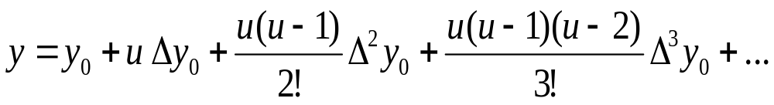
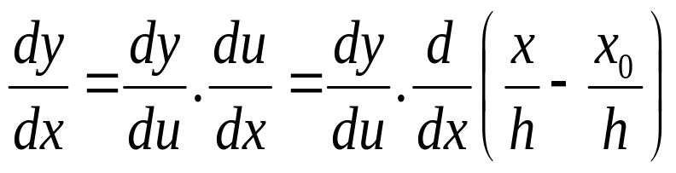
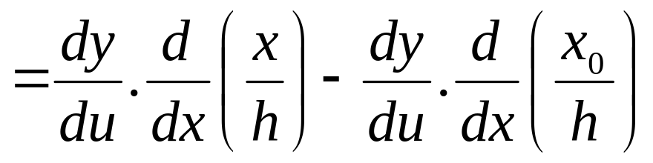
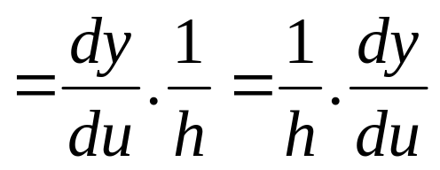
Numerical Differentiation
Consider Newton’s Forward difference formula, putting u = (x - x₀)/h, we get
Then,

Slide 5
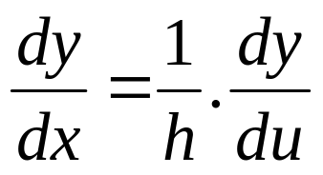
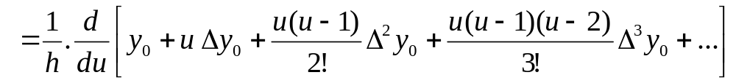
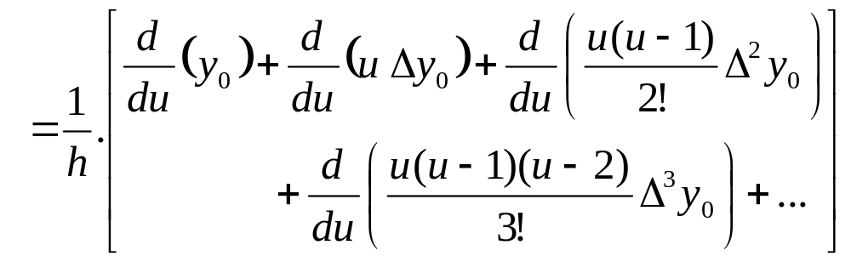
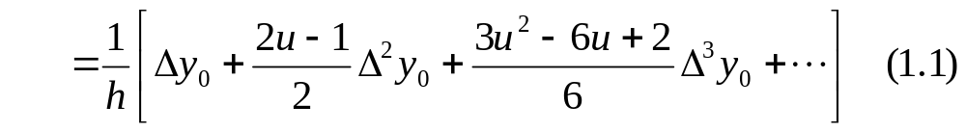
Numerical Differentiation
Therefore,

Slide 6
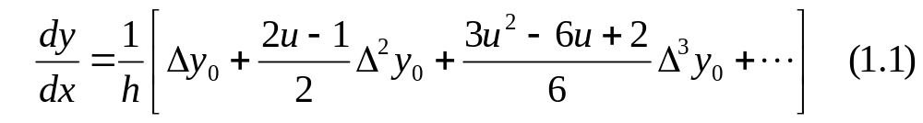
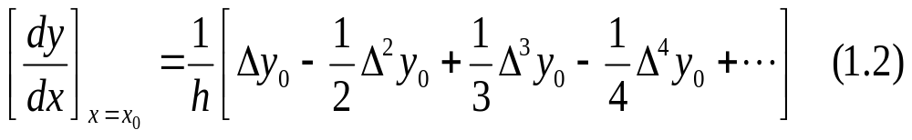
Numerical Differentiation
For tabular values of x, the formula takes a simpler form, by setting x = x₀ we obtain u = 0 [since u = (x - x₀)/h] and hence (1.1) gives

Slide 7
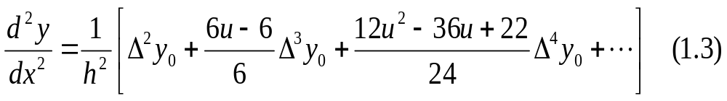
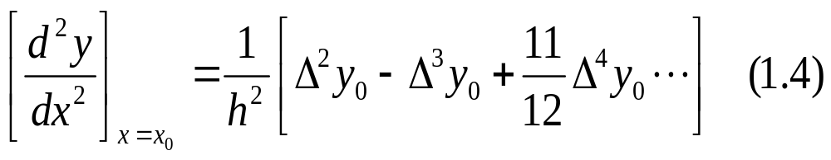
Numerical Differentiation: Double Derivatives
We know,
Differentiating (1.1) again, we obtain,
At x = x₀, u =0 and we obtain
Formulae for computing higher derivatives may be obtained by successive differentiation.

Slide 8
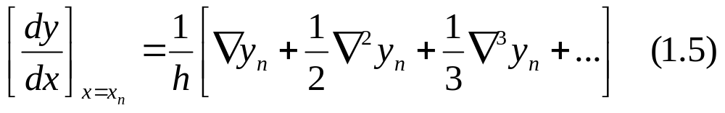
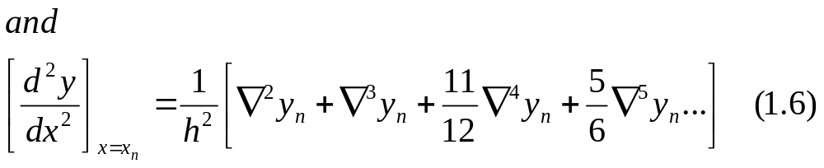
Numerical Differentiation: Higher Derivatives
Different formulae can be derived by starting with other interpolation formulae.
(a) Newton’s backward difference formula gives

Slide 9
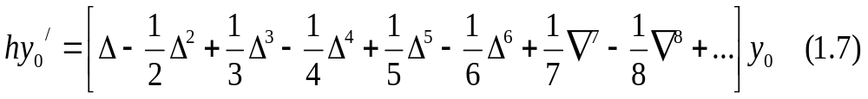
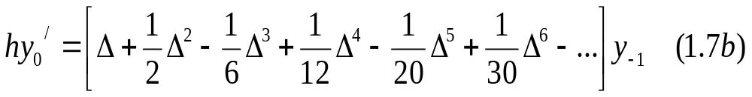
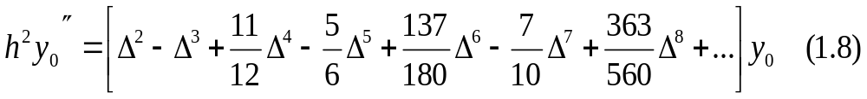
Numerical Differentiation: Higher Derivatives
If a derivative is required near the start of a table the following formulae may be used

Slide 10
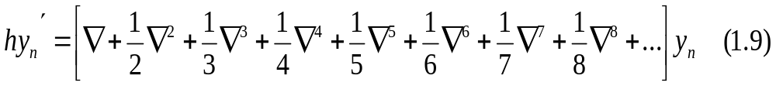
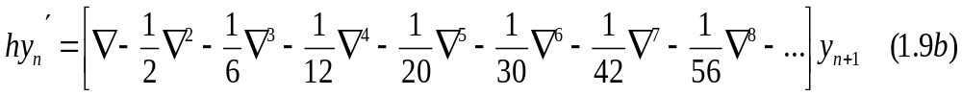
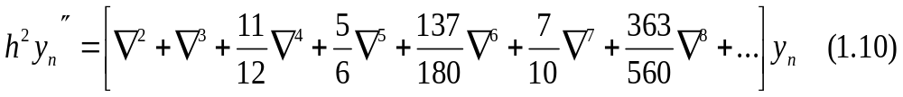
Numerical Differentiation: Higher Derivatives
If a derivative is required near the end of a table the following formulae may be used

Slide 11
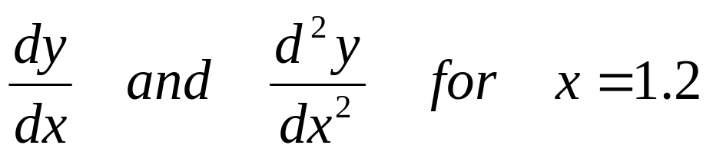
Example
From the following table of values of x and y, obtain
x | 1.0 | 1.2 | 1.4 | 1.6 | 1.8 | 2.0 | 2.2
y | 2.7183 | 3.3201 | 4.0552 | 4.953 | 6.0496 | 7.3891 | 9.025
Solution
The difference table is in the next slide:

Slide 12
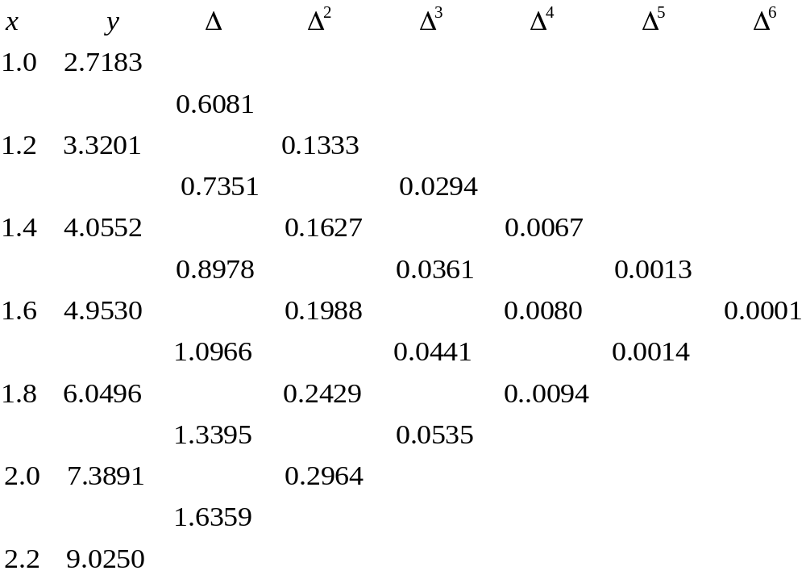
Solution
y₀
x₀
Δ y₀
Δ² y₀
Δ³ y₀
Δ⁴ y₀
Δ⁵ y₀

Slide 13
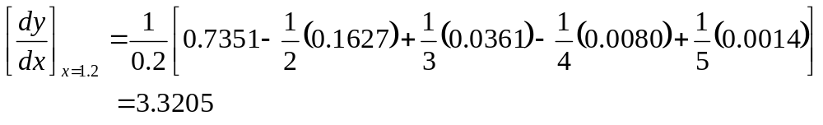
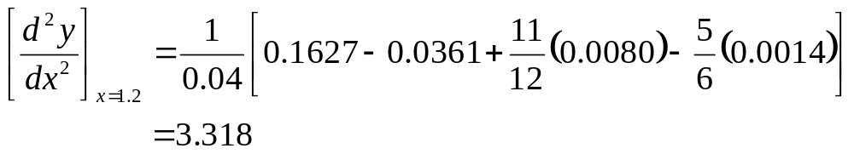
Solution
Here x₀ = 1.2, y₀ = 3.3201 and h = 0.2

Slide 14
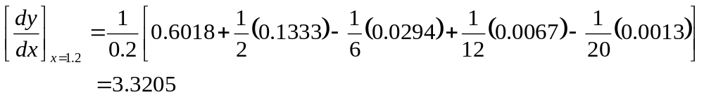
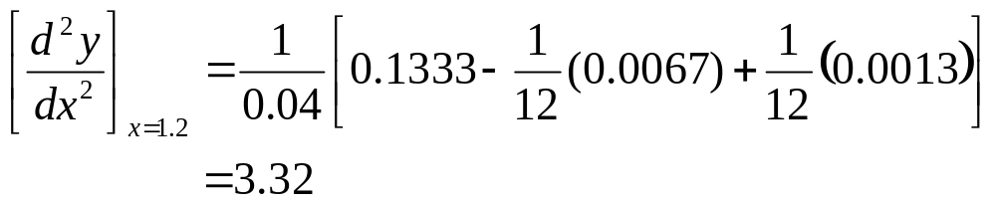
Alternative Solution
Here x₀ = 1.2, y₀ = 3.3201 and h = 0.2
Then, x₋₁ = 1.0, y₋₁ = 2.7183 and h = 0.2

Slide 15
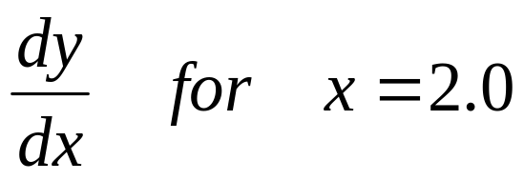
Class Work
From the following table of values of x and y, obtain
x | 1.0 | 1.2 | 1.4 | 1.6 | 1.8 | 2.0 | 2.2
y | 2.7183 | 3.3201 | 4.0552 | 4.953 | 6.0496 | 7.3891 | 9.025
Answer: 7.3896

Slide 16
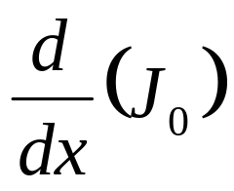
Class Work
Find x = 0.1 from the following table:
x | 0.0 | 0.1 | 0.2 | 0.3 | 0.4
J₀(x) | 1.0000 | 0.9975 | 0.9900 | 0.9776 | 0.9604

Slide 17
Class Work
The following table gives the angular displacements θ (radians) at different intervals of time t (seconds).
Calculate the angular velocity at the instant x = 0.408.
θ | 0.052 | 0.105 | 0.168 | 0.242 | 0.327 | 0.408 | 0.489
t | 0 | 0.02 | 0.04 | 0.06 | 0.08 | 0.10 | 0.12

Slide 18
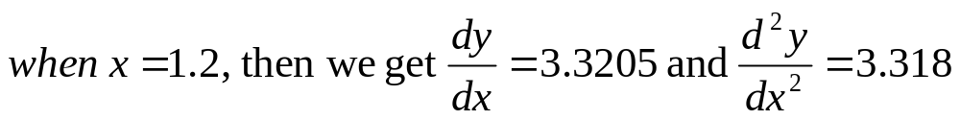
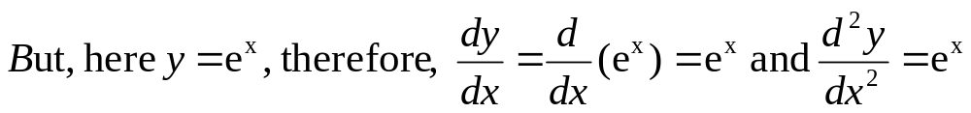
Errors in Numerical Differentiation
In the given example,
x | 1.0 | 1.2 | 1.4 | 1.6 | 1.8 | 2.0 | 2.2
y | 2.7183 | 3.3201 | 4.0552 | 4.953 | 6.0496 | 7.3891 | 9.025
Therefore, here we can see with each differentiation, some error occurs in the derivatives.
The error increases with higher derivatives.
This is because, in interpolation the new polynomial would agree at the set of points.
But, their slopes at these points may vary considerably.

Slide 19
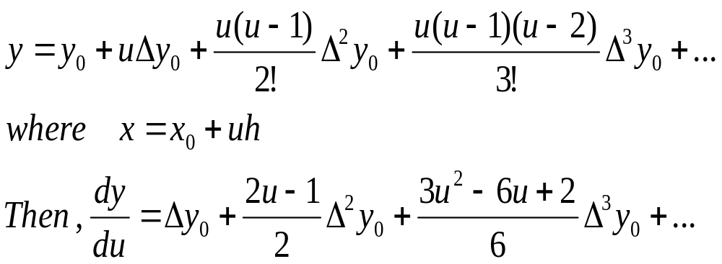
Maximum Value of a Tabulated Function
It is known that the maximum values of a function can be found by equating the first derivative to zero and solving for the variable.
The same procedure can be applied to determine the maxima of a tabulated function.
Consider Newton’s forward difference formula

Slide 20
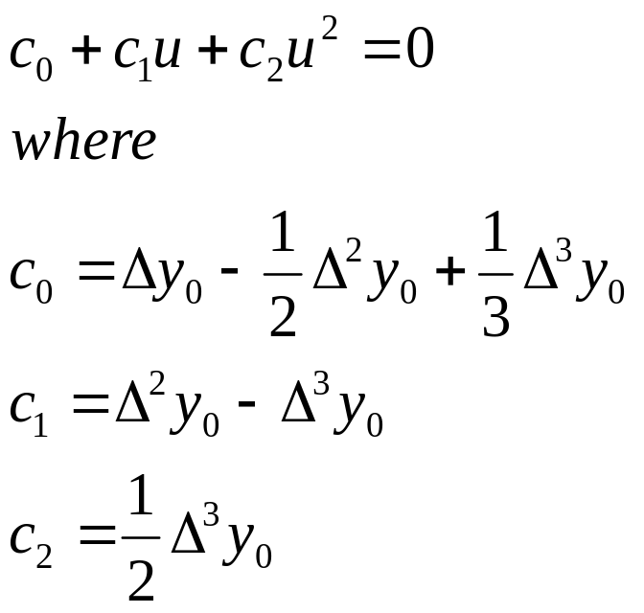
Maximum Value of a Tabulated Function
For maxima, dy/dx = 0.
Hence, terminating the right-hand side after the third difference (for simplicity) and equating it to zero.
We obtain the quadratic for u.
The values of x can then be found from the relation x = x₀+uh

Slide 21
Example
From the following table, find x, correct to two decimal places, for which y the function has the maximum value and find the value of y.
x | 1.2 | 1.3 | 1.4 | 1.5 | 1.6
y | 0.9320 | 0.9636 | 0.9855 | 0.9975 | 0.9996
Solution
The difference table is in the next slide:

Slide 22
Solution
x | y
1.2 | 0.9320
 |  | 0.0316
1.3 | 0.9636 |  | -0.0097
 |  | 0.0219
1.4 | 0.9855 |  | -0.0099
 |  | 0.0120
1.5 | 0.9975 |  | -0.0099
 |  | 0.0021
1.6 | 0.9996

Slide 23
Solution
Let, x₀ = 1.2 and we can terminate the formula after the second difference (since the difference is very negligible).
Now we have,
0.0316+(2u – 1)(-0.0097)/2 = 0
Therefore, u = 3.8 and x = x₀ + uh = 1.2+(3.8)(0.1) = 1.58
For x = 1.58, we have the maximum value of y.
Using Newton’s backward difference formula at x_{n}= 1.6 gives,
y(1.58) = 1.0 (CLASS WORK)
That is the maximum value of y in the function.

Slide 24
Introduction
The general problem of numerical integration may be stated as follows:
Given a set of data points (x₀, y₀), (x₁, y₁), ..., (x_{n}, y_{n}) of a function y = f(x), where f(x) is not known explicitly.
It is required to compute the value of the definite integral
In this case we have to replace f(x) by an interpolating polynomial φ(x) and obtain an approximate value of the definite integral by integrating φ(x).
Thus, different integration formulae can be obtained depending upon the type of the interpolation formula used.

Slide 25
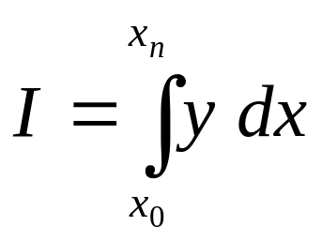
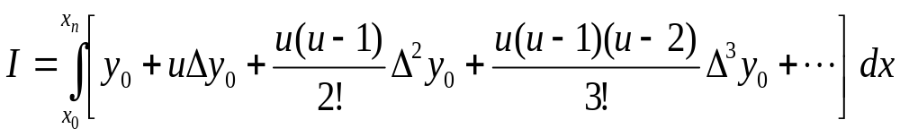
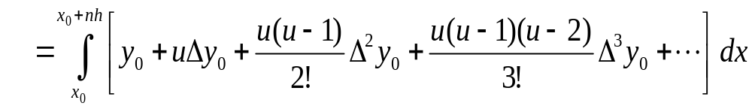
Numerical Integration
Let, the interval [a, b] be divided into n equal subintervals such that a = x₀ < x₁< ... <x_{n} = b.
Then, x_{n} = x₀ + nh.
Hence, the integral becomes
Integrating Newton’s forward difference formula, we obtain

Slide 26
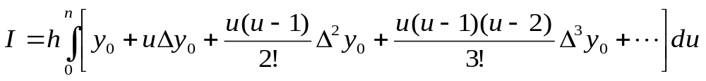
Numerical Integration
Since x = x₀ + hu from which we get dx = hdu.
The limit of integration for x are x₀ and x₀+nh
We know, u = (x - x₀)/h
Therefore, for u, the corresponding lower limit is (x₀ - x₀)/h = 0.
For u, the corresponding upper limit is (x_{n} - x₀)/h = (x₀ + hn - x₀)/h = n .
We therefore have,

Slide 27
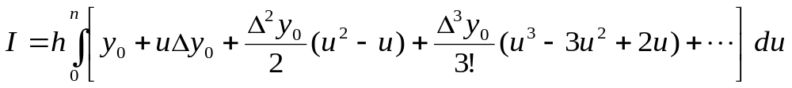
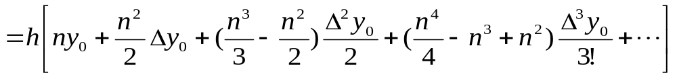
Numerical Integration
Now,
Which gives on simplification
From this general formula we can obtain different integration formulae by putting n = 1, 2, 3, ... etc.

Slide 28
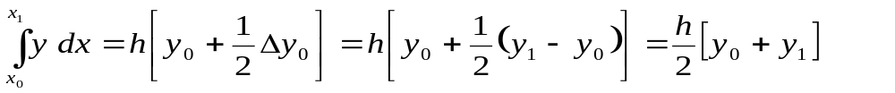
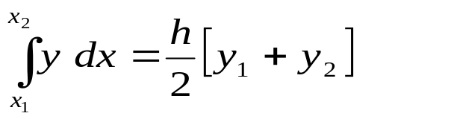
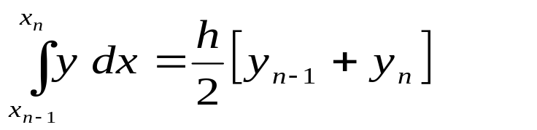
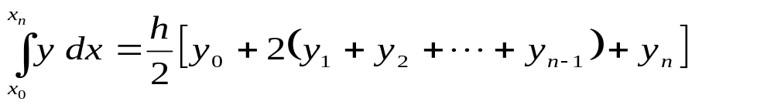
Trapezoidal Rule
Setting n = 1 in the general formula (1) and neglecting all differences above the first we obtain for the first interval [x₀, x₁]
For the next interval [x₁, x₂], we deduce similarly … (and so on) …
Similarly, for the last interval [x_{n-1}, x_{n}], we have
Combining all these expressions, we obtain the rule
This rule is known as the Trapezoidal Rule.

Slide 29
Trapezoidal Rule: Geometric Significance
The geometrical significance of this rule is that
  The curve y = f(x) is replaced by n straight lines joining the points (x₀, y₀) and (x₁, y₁); (x₁, y₁) and (x₂, y₂); ... (x_{n-1}, y_{n-1}), and (x_{n}, y_{n}).
  The area bounded by the curve y = f(x), within the x-coordinates x = x₀, and x = x_{n}, and the x-axis is then approximately equivalent to the sum of the areas of the n trapeziums obtained.

Slide 30
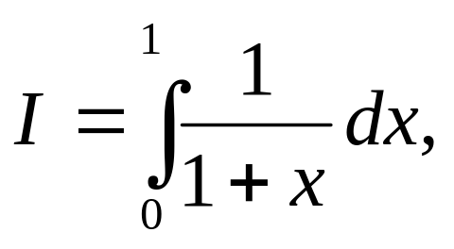
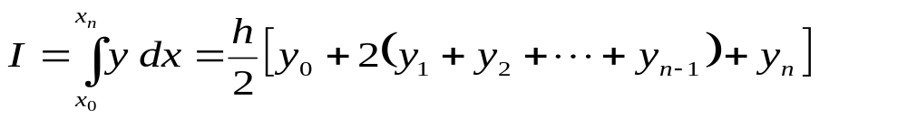
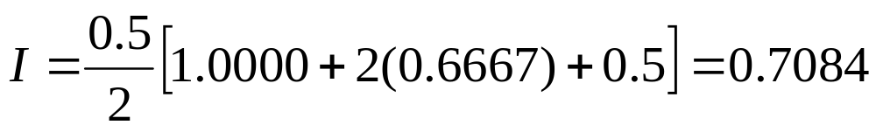
Example
Evaluate
for h = 0.5, 0.25 and 0.125 using Trapezoidal rule (correct to three decimal places).
Solution
The values of x and y are tabulated below h = 0.5
x | 0 | 0.5 | 1.0
y | 1.0000 | 0.6667 | 0.5
Trapezoidal rule gives

Slide 31
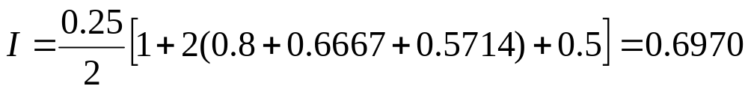
Example (Cont.)
Solution
The values of x and y are tabulated below h = 0.25
x | 0 | 0.25 | 0.5 | 0.75 | 1
y | 1 | 0.8 | 0.6667 | 0.5714 | 0.5
Trapezoidal rule gives

Slide 32
Example (Cont.)
Solution
The values of x and y are tabulated below h = 0.125 (CLASS WORK)
Answer: I = 0.6941

Slide 33
Class Work
A solid of revolution is formed by rotating about the x-axis the area between the x-axis, the lines x = 0 and x = 1, and a curve through the points with the following coordinates
x | 0.00 | 0.25 | 0.50 | 0.75 | 1.00
y | 1.0000 | 0.9896 | 0.9589 | 0.9089 | 0.8415
Estimate the volume of the solid formed using Trapezoidal rule, giving the answer to three decimal places.
Answer: 0.9447625

Slide 34
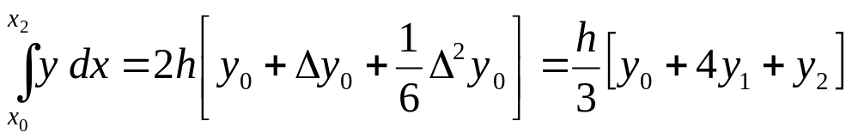
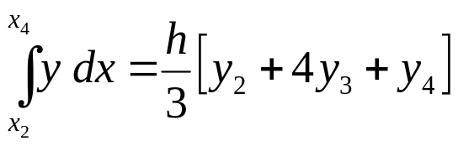
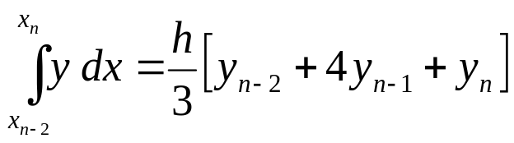

Simpson’s 1/3-Rule
Setting n = 2 in the general formula (1) and neglecting all differences above the second we obtain for the first interval [x₀, x₂]
For the next interval [x₂, x₄], we deduce similarly … (and so on) …
Finaly, for the last interval [x_{n-2}, x_{n}], we have
Combining all these expressions, we obtain the rule
This rule is known as the Simson’s 1/3 Rule (or Simpson’s Rule).

Slide 35
Simpson’s 1/3 Rule: Geometric Significance
The geometrical significance of this rule is that
  Replacing the curve y = f(x) is by n/2 arcs of second degree polynomials or parabolas joining the points (x₀, y₀) and (x₂, y₂); (x₂, y₂) and (x₄, y₄); ... (x_{n-2}, y_{n-2}), and (x_{n}, y_{n}).
  It should be noted that this rule requires the division of the whole range into an even number of subintervals of width h.

Slide 36

Example
Evaluate
correct to three decimal places for h = 0.5, 0.25 and 0.125 using Simpson’s 1/3 rule.
Solution
The values of x and y are tabulated below h = 0.5
x | 0 | 0.5 | 1.0
y | 1.0000 | 0.6667 | 0.5
Simpson’s rule gives

Slide 37
Example (Cont.)
CLASS WORK: Do the same for h = 0.25 and h = 0.125
Solution
For h = 0.25
Simpson’s rule gives I = 0.6932
For h = 0.125
Simpson’s rule gives I = 0.6932

Slide 38

Class Work
Apply trapezoidal and Simpson’s 1/3 rules to the integral for 10, 20, 30, 40, and 50 subintervals.

Slide 39


Simpson’s 3/8-Rule
The rule is obtained by putting n = 3 in the general equation and neglecting all the differences above the third we have,

Slide 40


Simpson’s 3/8-Rule
Summing up we obtain
This rule called Simpson’s 3/8-rule, is not so accurate as Simpson’s rule.

Slide 41

Class Work
Apply trapezoidal and Simpson’s 3/8 rules to the integral for 3, 6 and 12subintervals.

Slide 42



Weddle’s Rule
The rule is obtained by putting n = 6 in the general equation i.e., and neglecting all the differences above the sixth we have,
Here the coefficient of Δ⁶y₀ differs from 3/10 by the small fraction 1/140 (i.e., 3/10 – 41/140 = 1/140, which is very negligible)
Hence if we replace this coefficient by 3/10, we commit an error of only
If the value of h is such that the sixth differences are small, the error committed will be negligible.
We therefore change the last term to

Slide 43



Weddle’s Rule
Then replace all differences by their values in terms of the given y’s. The result reduces down to
Adding all such expressions as these from x₀ to x_{n}, where n is now a multiple of six, we get Weddle’s Rule

Slide 44
Weddle’s Rule: More
Weddle’s rule is more accurate, in general than Simpson’s rule,
It requires at least seven consecutive values of the function.
The geometric meaning of Weddle’s Rule is that we replace the graph of the function by n/6 arcs of fifth-degree polynomials.

Slide 45


Example
Compute the value of the definite integral for h = 0.2 using Weddle’s rule
Solution
The values of this function is computed for each point of subdivision.
By Weddle’s rule we get
I=3(0.2)[1.3863+5(1.4351)+1.4816+6(1.5261)+1.5686+5(1.6094)+1.6487]/10
=1.827858

Slide 46

Home Work
Compute the value of the definite integral for h = 0.1 using Weddle’s rule
Answer: 4.05095

Slide 47


Romberg Integration
This method can be used to improve the approximate results obtained by the finite difference methods such as trapezoidal method.
Let T_{n} be the approximation of the integral , using trapezoid rule with 2^{n} subintervals.
Let I_{1,1} = T_{1.} (here, I is calculated with 2¹ segments)
Calculated I_{1,n}, I_{2,n} ..., I_{n,n} as follows:
    Set I_{1,n+1} = T_{n+1} (i.e., I₁,₂ = T₂, calculated with 2² segments, I_{1,3} = T₃, calculated with 2³ segments, I_{1,4} = T₄, calculated with 2⁴ segments)
    Next, for j = 2, 3, …, n

Slide 48
Romberg Integration
We have,
The index j represents the order of interpolation.
For example, j = 1 represents the values obtained from the regular Trapezoidal rule.
The index k represents the more or less accurate estimate of the integral.
The value of the integral with k + 1 index is more accurate than with k index.
With this notation the following table can be formed.

Slide 49

Romberg Integration
We have,
With this notation the following table can be formed.
An advantage of this method is that the accuracy of the computed value is known at each step.

Slide 50


Romberg Integration
We have,
For j =2, k = 1,
For j = 3, k = 1,

Slide 51
Example
Use Romberg method to compute the following integral correct to three decimal places.
Use 2, 4 and 8-segment Trapezoidal rule results.

Slide 52

Example: Solution
Here, we have to calculate I using 2 = 2¹, 4 = 2² and 8 = 2³ intervals.
Therefore,
I_{1,1 =} T ₁, that is calculate I using Trapezoidal rule with 2¹ = 2 intervals.
I_{1,2} = T₂, that is calculate I using Trapezoidal rule with 2² = 4 intervals.
I_{1,3} = T₃, that is calculate I using Trapezoidal rule with 2³ = 8 intervals.
With this notation the following table can be formed.

Slide 53
Example: Solution
Using Trapezoidal Rule, we get [Class Work]
Now,

Slide 54
Solution (Cont.)
The table of values is therefore
0.7084
 | 0.6932
0.6970 |  | 0.6931
 | 0.6931
0.6941
Therefore, I = 0.6931

Slide 55

Home Work
Compute the values of
by using the trapezoidal rule with h=0.5, 0.25 and 0.125. Then obtain a better estimate by using Romberg’s method.

